Slide 1
Architectural Design
CO4: Student will be able to design & develop the software solutions for the growth of society

Slide 2
Contents
Architectural Design
Design Decisions, Views, Patterns, Application Architectures, Modeling
(Source: Pressman, R. Software Engineering: A Practitioner’s Approach. McGraw-Hill, 2005)

Slide 3
Definitions
The software architecture of a program or computing system is the structure or structures of the system which comprise
  The software components
  The externally visible properties of those components
  The relationships among the components
Software architectural design represents the structure of the data and program components that are required to build a computer-based system
An architectural design model is transferable
  It can be applied to the design of other systems
  It represents a set of abstractions that enable software engineers to describe architecture in predictable ways

Slide 4
Architectural Design Process
Basic Steps
  Creation of the data design
  Derivation of one or more representations of the architectural structure of the system
  Analysis of alternative architectural styles to choose the one best suited to customer requirements and quality attributes
  Elaboration of the architecture based on the selected architectural style
A database designer creates the data architecture for a system to represent the data components
A system architect selects an appropriate architectural style derived during system engineering and software requirements analysis

Slide 5
Emphasis on Software Components
A software architecture enables a software engineer to
  Analyze the effectiveness of the design in meeting its stated requirements
  Consider architectural alternatives at a stage when making design changes is still relatively easy
  Reduce the risks associated with the construction of the software
Focus is placed on the software component
  A program module
  An object-oriented class
  A database
  Middleware

Slide 6
Importance of Software Architecture
Representations of software architecture are an enabler for communication between all stakeholders interested in the development of a computer-based system
The software architecture highlights early design decisions that will have a profound impact on all software engineering work that follows and, as important, on the ultimate success of the system as an operational entity
The software architecture constitutes a relatively small, intellectually graspable model of how the system is structured and how its components work together

Slide 7
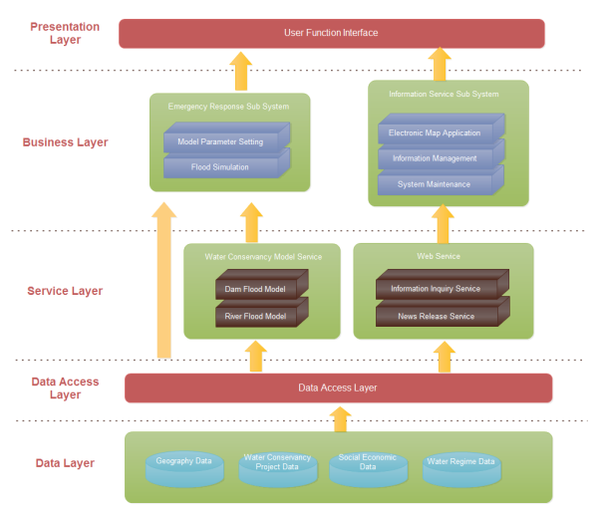
Example Software Architecture Diagram

Slide 8
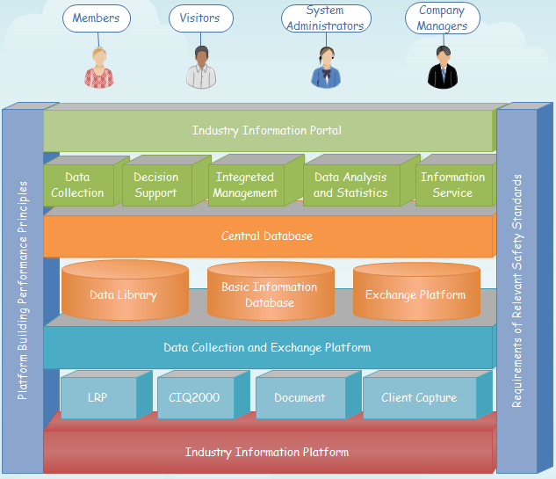
Example Software Architecture Diagrams

Slide 9
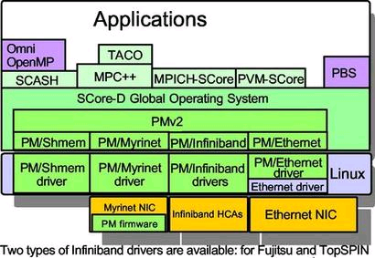
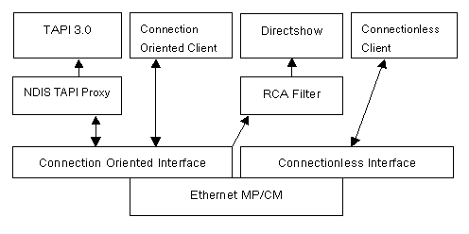
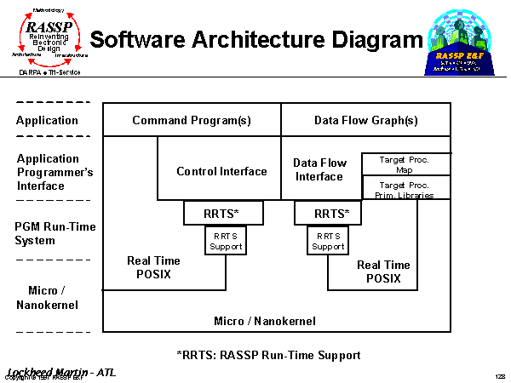
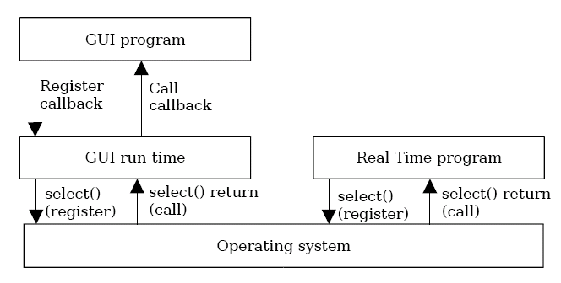
Example Software Architecture Diagrams

Slide 10
Data Design

Slide 11
Purpose of Data Design
Data design translates data objects defined as part of the analysis model into
  Data structures at the software component level
  A possible database architecture at the application level
It focuses on the representation of data structures that are directly accessed by one or more software components
The challenge is to store and retrieve the data in such way that useful information can be extracted from the data environment
"Data quality is the difference between a data warehouse and a data garbage dump"

Slide 12
Data Design Principles
The systematic analysis principles that are applied to function and behavior should also be applied to data
All data structures and the operations to be performed on each one should be identified
A mechanism for defining the content of each data object should be established and used to define both data and the operations applied to it
Low-level data design decisions should be deferred until late in the design process
The representation of a data structure should be known only to those modules that must make direct use of the data contained within the structure
A library of useful data structures and the operations that may be applied to them should be developed
A software programming language should support the specification and realization of abstract data types

Slide 13
Software Architectural Styles

Slide 14
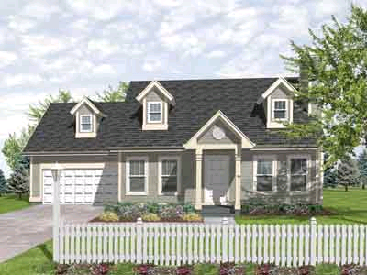
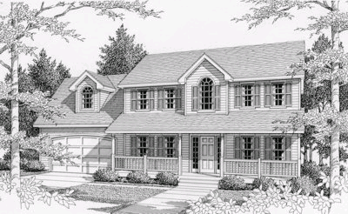
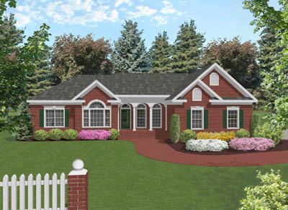
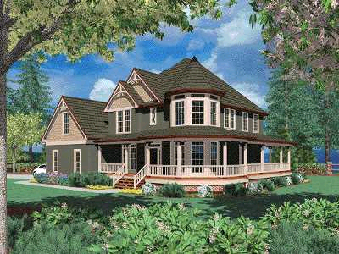
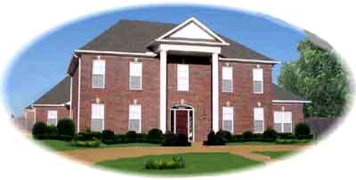
Common Architectural Styles of American Homes

Slide 15
Common Architectural Styles of American Homes
A-Frame
Four square
Ranch
Bungalow
Georgian
Split level
Cape Cod
Greek Revival
Tidewater
Colonial
Prairie Style
Tudor
Federal
Pueblo
Victorian

Slide 16
Software Architectural Style
The software that is built for computer-based systems exhibit one of many architectural styles
Each style describes a system category that encompasses
  A set of component types that perform a function required by the system
  A set of connectors (subroutine call, remote procedure call, data stream, socket) that enable communication, coordination, and cooperation among components
  Semantic constraints that define how components can be integrated to form the system
  A topological layout of the components indicating their runtime interrelationships
(Source: Bass, Clements, and Kazman. Software Architecture in Practice. Addison-Wesley, 2003)

Slide 17
A Taxonomy of Architectural Styles
Independent Components
Communicating
Processes
Event Systems
Implicit
Invocation
Explicit
Invocation
Client/Server
Peer-to-Peer
Data Flow
Data-Centered
Batch Sequential
Pipe and
Filter
Repository
Blackboard
Virtual Machine
Call and Return
Main Program
and Subroutine
Object
Oriented
Layered
Interpreter
Rule-Based
System
Remote Procedure Call

Slide 18
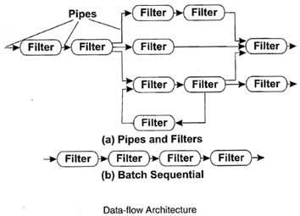
Data Flow Style

Slide 19
Data Flow Style
Has the goal of modifiability
Characterized by viewing the system as a series of transformations on successive pieces of input data
Data enters the system and then flows through the components one at a time until they are assigned to output or a data store
Batch sequential style
  The processing steps are independent components
  Each step runs to completion before the next step begins
Pipe-and-filter style
  Emphasizes the incremental transformation of data by successive components
  The filters incrementally transform the data (entering and exiting via streams)
  The filters use little contextual information and retain no state between instantiations
  The pipes are stateless and simply exist to move data between filters
(More on next slide)

Slide 20
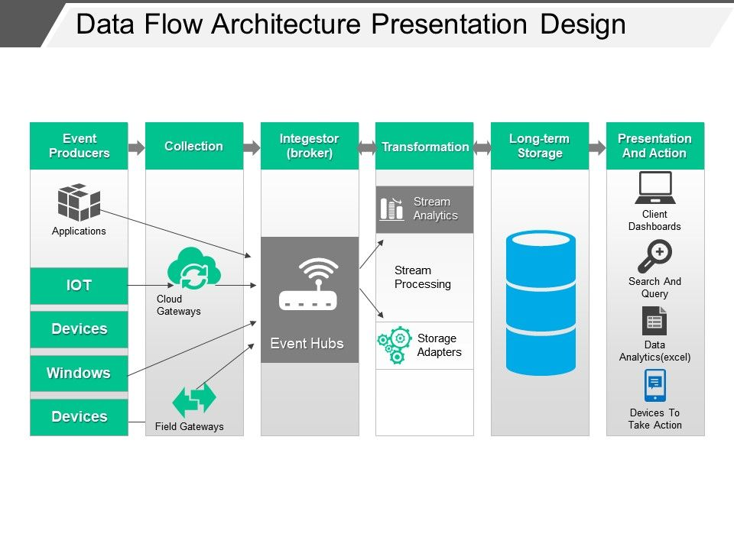

Slide 21
Data Flow Style (continued)
Advantages
  Has a simplistic design in the limited ways in which the components interact with the environment
  Consists of no more and no less than the construction of its parts
  Simplifies reuse and maintenance
  Is easily made into a parallel or distributed execution in order to enhance system performance
Disadvantages
  Implicitly encourages a batch mentality so interactive applications are difficult to create in this style
  Ordering of filters can be difficult to maintain so the filters cannot cooperatively interact to solve a problem
  Exhibits poor performance
    Filters typically force the least common denominator of data representation (usually ASCII stream)
    Filter may need unlimited buffers if they cannot start producing output until they receive all of the input
    Each filter operates as a separate process or procedure call, thus incurring overhead in set-up and take-down time
(More on next slide)

Slide 22
Data Flow Style (continued)
Use this style when it makes sense to view your system as one that produces a well-defined easily identified output
  The output should be a direct result of sequentially transforming a well-defined easily identified input in a time-independent fashion

Slide 23
Call-and-Return Style
Main module
Subroutine B
Subroutine A
Subroutine A-1
Subroutine A-2
Application layer
Class V
Class W
Transport layer
Network layer
Class X
Class Y
Data layer
Class Z
Physical layer

Slide 24
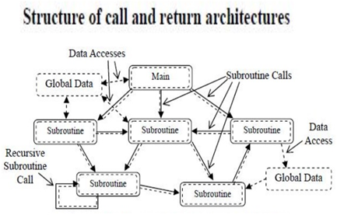
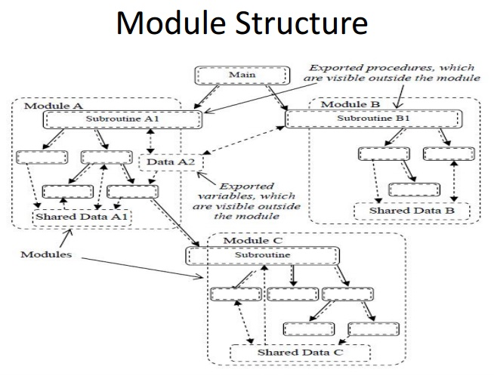

Slide 25
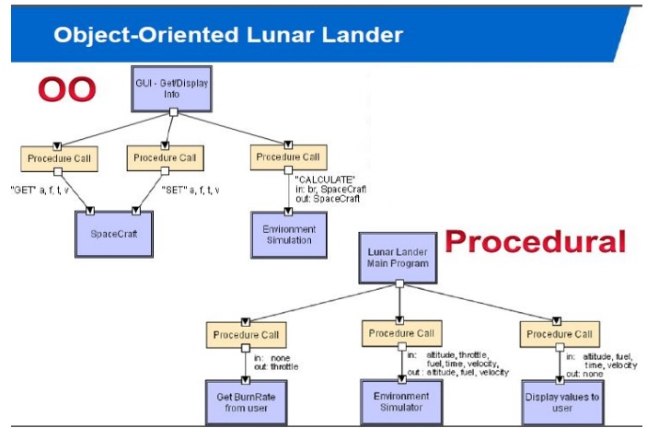

Slide 26
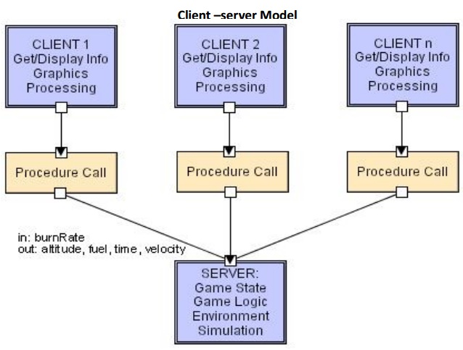

Slide 27
Call-and-Return Style
Has the goal of modifiability and scalability
Has been the dominant architecture since the start of software development
Main program and subroutine style
  Decomposes a program hierarchically into small pieces (i.e., modules)
  Typically has a single thread of control that travels through various components in the hierarchy
Remote procedure call style
  Consists of main program and subroutine style of system that is decomposed into parts that are resident on computers connected via a network
  Strives to increase performance by distributing the computations and taking advantage of multiple processors
  Incurs a finite communication time between subroutine call and response
(More on next slide)

Slide 28
Call-and-Return Style (continued)
Object-oriented or abstract data type system
  Emphasizes the bundling of data and how to manipulate and access data
  Keeps the internal data representation hidden and allows access to the object only through provided operations
  Permits inheritance and polymorphism
Layered system
  Assigns components to layers in order to control inter-component interaction
  Only allows a layer to communicate with its immediate neighbor
  Assigns core functionality such as hardware interfacing or system kernel operations to the lowest layer
  Builds each successive layer on its predecessor, hiding the lower layer and providing services for the upper layer
  Is compromised by layer bridging that skips one or more layers to improve runtime performance
Use this style when the order of computation is fixed, when interfaces are specific, and when components can make no useful progress while awaiting the results of request to other components

Slide 29
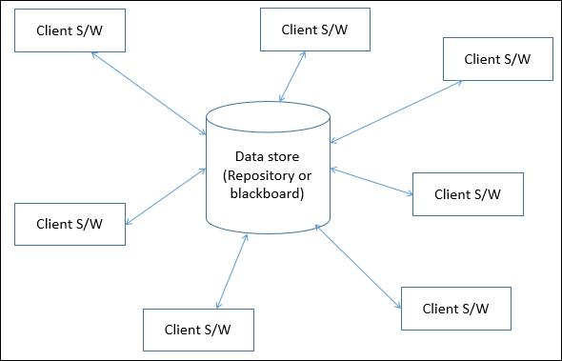
Data-Centered Style

Slide 30
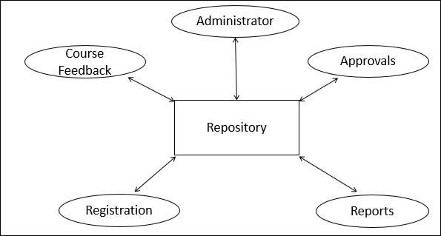
This approach is widely used in DBMS, library information system, the interface repository in CORBA, compilers and CASE (computer aided software engineering) environments.

Slide 31
Data-Centered Style (continued)
Has the goal of integrating the data
Refers to systems in which the access and update of a widely accessed data store occur
A client runs on an independent thread of control
The shared data may be a passive repository or an active blackboard
  A blackboard notifies subscriber clients when changes occur in data of interest
At its heart is a centralized data store that communicates with a number of clients
Clients are relatively independent of each other so they can be added, removed, or changed in functionality
The data store is independent of the clients
(More on next slide)

Slide 32
Data-Centered Style (continued)
Use this style when a central issue is the storage, representation, management, and retrieval of a large amount of related persistent data
Note that this style becomes client/server if the clients are modeled as independent processes

Slide 33
Virtual Machine Style
Program Data
Program
Instructions
Interpretation
Engine
Program
Internal State

Slide 34
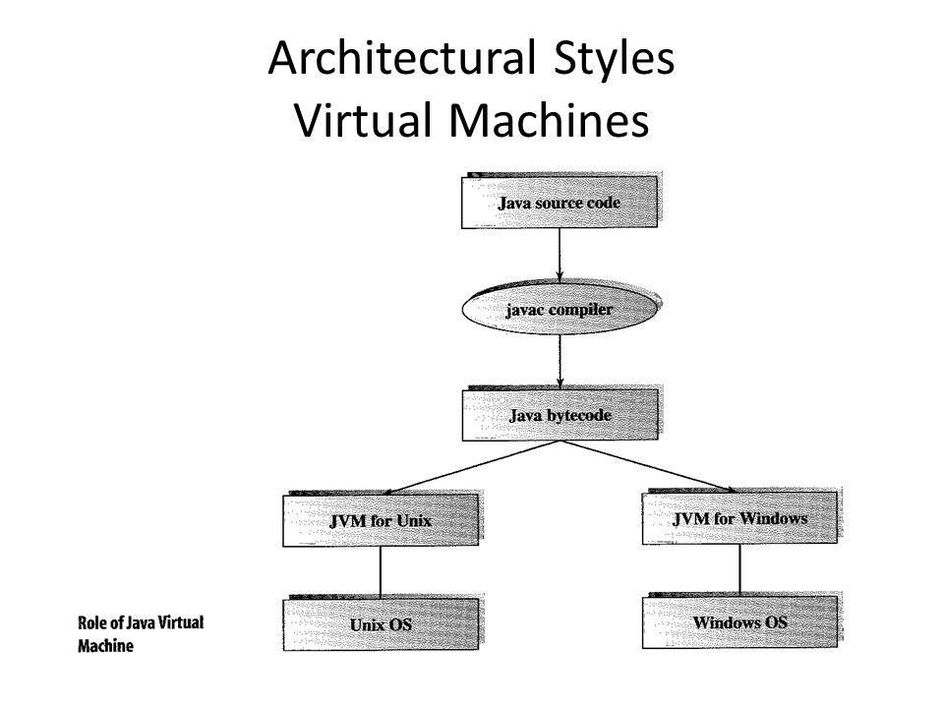

Slide 35
Virtual Machine Style
Has the goal of portability
Software systems in this style simulate some functionality that is not native to the hardware and/or software on which it is implemented
  Can simulate and test hardware platforms that have not yet been built
  Can simulate "disaster modes" as in flight simulators or safety-critical systems that would be too complex, costly, or dangerous to test with the real system
Examples include interpreters, rule-based systems, and command language processors
Interpreters
  Add flexibility through the ability to interrupt and query the program and introduce modifications at runtime
  Incur a performance cost because of the additional computation involved in execution
Use this style when you have developed a program or some form of computation but have no make of machine to directly run it on

Slide 36
Independent Component Style
Client A
Client B
Server
Client C
Client D
Peer W
Peer X
Peer Y
Peer Z

Slide 37
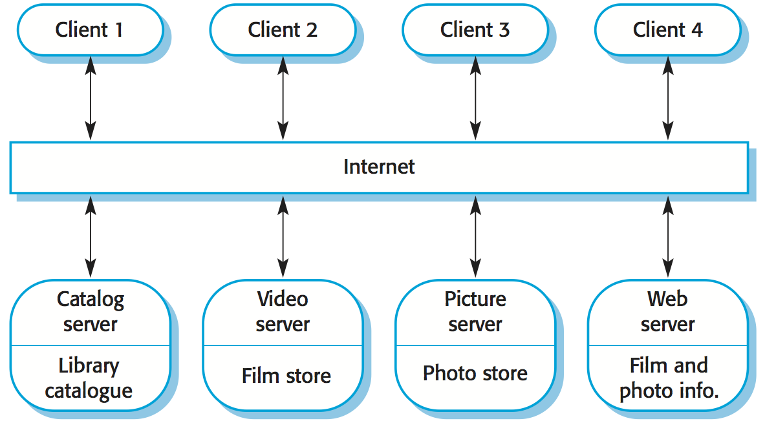
A client-server architecture for a film library

Slide 38
Independent Component Style
Consists of a number of independent processes that communicate through messages
Has the goal of modifiability by decoupling various portions of the computation
Sends data between processes but the processes do not directly control each other
Event systems style
  Individual components announce data that they wish to share (publish) with their environment
  The other components may register an interest in this class of data (subscribe)
  Makes use of a message component that manages communication among the other components
  Components publish information by sending it to the message manager
  When the data appears, the subscriber is invoked and receives the data
  Decouples component implementation from knowing the names and locations of other components
(More on next slide)

Slide 39
Independent Component Style (continued)
Communicating processes style
  These are classic multi-processing systems
  Well-known subtypes are client/server and peer-to-peer
  The goal is to achieve scalability
  A server exists to provide data and/or services to one or more clients
  The client originates a call to the server which services the request
Use this style when
  Your system has a graphical user interface
  Your system runs on a multiprocessor platform
  Your system can be structured as a set of loosely coupled components
  Performance tuning by reallocating work among processes is important
  Message passing is sufficient as an interaction mechanism among components

Slide 40
Heterogeneous Styles
Systems are seldom built from a single architectural style
Three kinds of heterogeneity
  Locationally heterogeneous
    The drawing of the architecture reveals different styles in different areas (e.g., a branch of a call-and-return system may have a shared repository)
  Hierarchically heterogeneous
    A component of one style, when decomposed, is structured according to the rules of a different style
  Simultaneously heterogeneous
    Two or more architectural styles may both be appropriate descriptions for the style used by a computer-based system

Slide 41
Architectural Design Process

Slide 42
Architectural Design Steps
Represent the system in context
Define archetypes
Refine the architecture into components
Describe instantiations of the system
"A doctor can bury his mistakes, but an architect can only advise
his client to plant vines." Frank Lloyd Wright

Slide 43
1. Represent the System in Context
"Super"ordinate systems
Used by
Uses
I/F
I/F
I/F
Target system
Produces or
consumes
Produces or
consumes
Peers
Actors
I/F
I/F
Depends on
"Sub"ordinate systems
(More on next slide)

Slide 44
1. Represent the System in Context (continued)
Use an architectural context diagram (ACD) that shows
  The identification and flow of all information into and out of a system
  The specification of all interfaces
  Any relevant support processing from/by other systems
An ACD models the manner in which software interacts with entities external to its boundaries
An ACD identifies systems that interoperate with the target system
  Super-ordinate systems
    Use target system as part of some higher level processing scheme
  Sub-ordinate systems
    Used by target system and provide necessary data or processing
  Peer-level systems
    Interact on a peer-to-peer basis with target system to produce or consume data
  Actors
    People or devices that interact with target system to produce or consume data

Slide 45
2. Define Archetypes
Archetypes indicate the important abstractions within the problem domain (i.e., they model information)
An archetype is a class or pattern that represents a core abstraction that is critical to the design of an architecture for the target system
It is also an abstraction from a class of programs with a common structure and includes class-specific design strategies and a collection of example program designs and implementations
Only a relatively small set of archetypes is required in order to design even relatively complex systems
The target system architecture is composed of these archetypes
  They represent stable elements of the architecture
  They may be instantiated in different ways based on the behavior of the system
  They can be derived from the analysis class model
The archetypes and their relationships can be illustrated in a UML class diagram

Slide 46
Example Archetypes in Humanity
Addict/Gambler
Amateur
Beggar
Clown
Companion
Damsel in distress
Destroyer
Detective
Don Juan
Drunk
Engineer
Father
Gossip
Guide
Healer
Hero
Judge
King
Knight
Liberator/Rescuer
Lover/Devotee
Martyr
Mediator
Mentor/Teacher
Messiah/Savior
Monk/Nun
Mother
Mystic/Hermit
Networker
Pioneer
Poet
Priest/Minister
Prince
Prostitute
Queen
Rebel/Pirate
Saboteur
Samaritan
Scribe/Journalist
Seeker/Wanderer
Servant/Slave
Storyteller
Student
Trickster/Thief
Vampire
Victim
Virgin
Visionary/Prophet
Warrior/Soldier
(Source: http://www.myss.com/ThreeArchs.asp)

Slide 47
Example Archetypes in Software Architecture
Node
Detector/Sensor
Indicator
Controller
Manager
Moment-Interval
Role
Description
Party, Place, or Thing
(Source: Pressman)
(Source: Archetypes, Color, and the Domain Neutral Component)

Slide 48
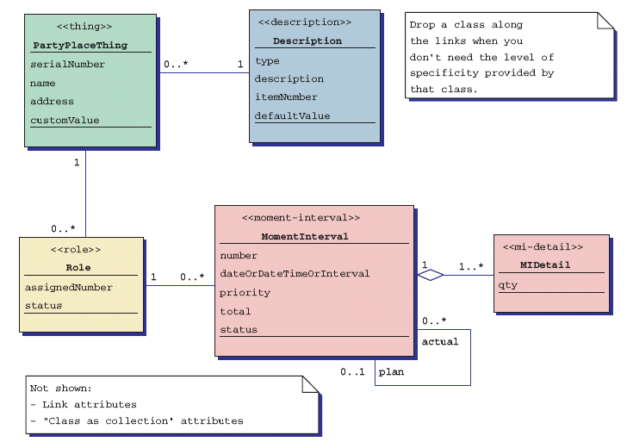
Archetypes – their attributes

Slide 49
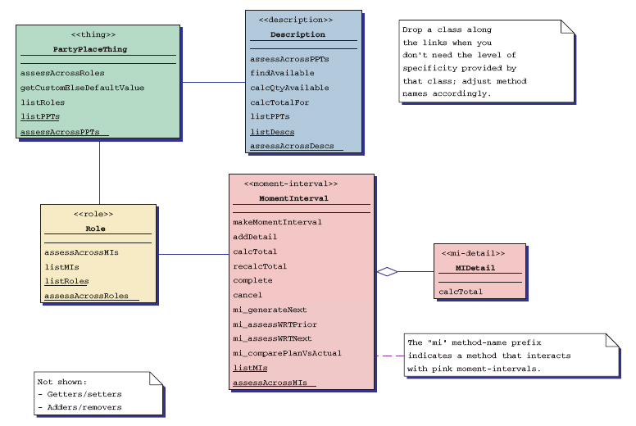
Archetypes – their methods

Slide 50
3. Refine the Architecture into Components
Based on the archetypes, the architectural designer refines the software architecture into components to illustrate the overall structure and architectural style of the system
These components are derived from various sources
  The application domain provides application components, which are the domain classes in the analysis model that represent entities in the real world
  The infrastructure domain provides design components (i.e., design classes) that enable application components but have no business connection
    Examples: memory management, communication, database, and task management
  The interfaces in the ACD imply one or more specialized components that process the data that flow across the interface
A UML class diagram can represent the classes of the refined architecture and their relationships

Slide 51
4. Describe Instantiations of the System
An actual instantiation of the architecture is developed by applying it to a specific problem
This demonstrates that the architectural structure, style and components are appropriate
A UML component diagram can be used to represent this instantiation

